Slide 1
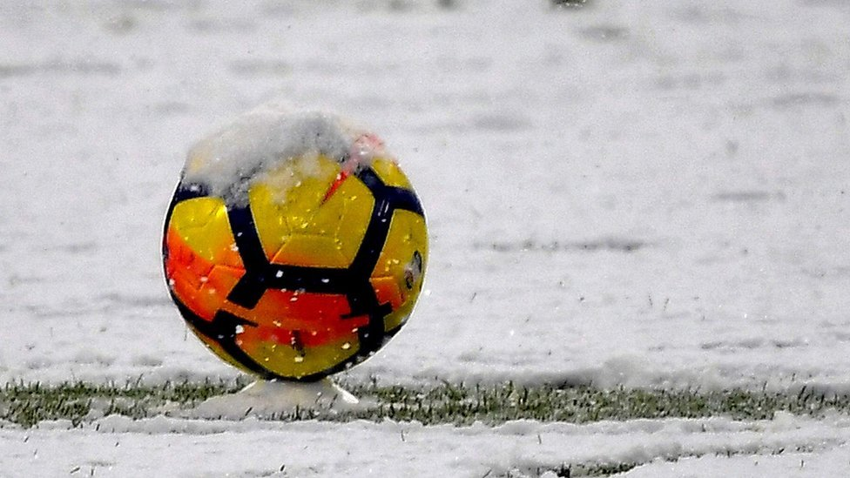
Home Field Advantage & the Effects of Weather in
Premier League Soccer
By Ben Johnson-Laird & Rob Alterman

Slide 2
What we looked at...
Is there a home-field advantage?
Does bad weather affect total goals scored?
Does home-field advantage exist when there is bad weather?
Data Sources
Footystats.org
English Premier League game data
World Weather Online - Historical Weather API
Past weather data for coordinates of soccer stadium on given day and time

Slide 3
Background
20 Teams for the 2018 season
Each team plays every other team once at home and once away
Total 380 matches, or 190 paired matches
Home-field advantage
Measured by comparing corresponding pairs of matches, i.e. Team A (home team) vs. Team B & Team B (home team) vs. Team A
Bad weather
Defined as any of: >= 0.4mm of rain per hour; bad visibility; freezing temperature; or >= 25 mph winds
Gives 35 bad weather matches

Slide 4
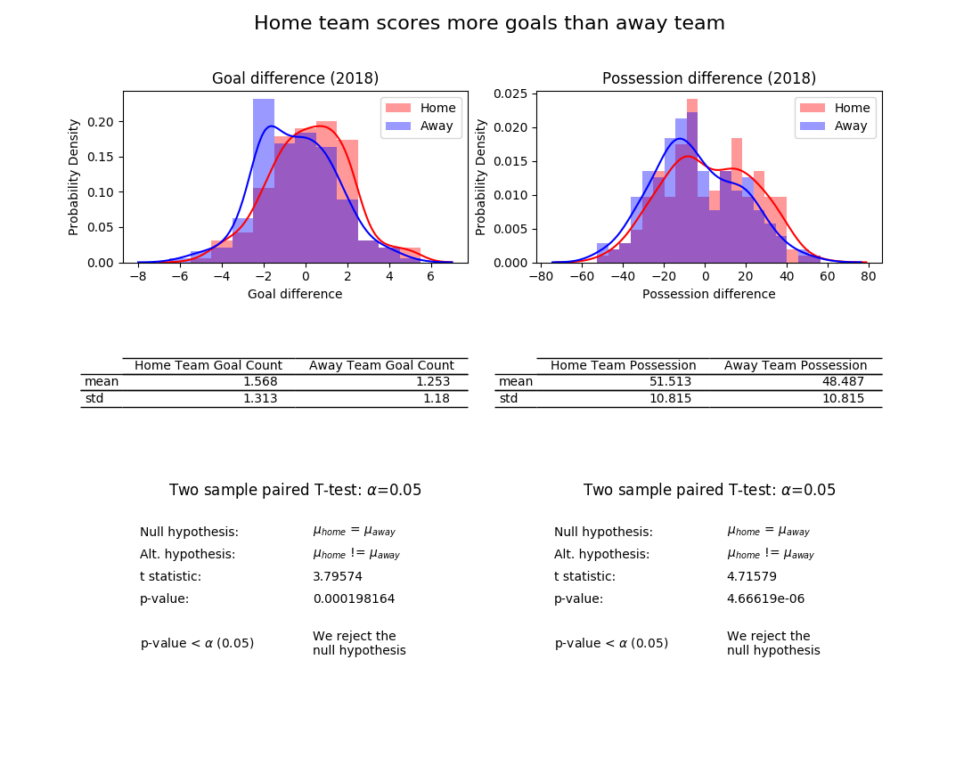
Notes:
When at home, teams score 0.3 more goal per match than when away against the same opposition, away.
Playing at home, a team has ~3 percent more possession

Slide 5
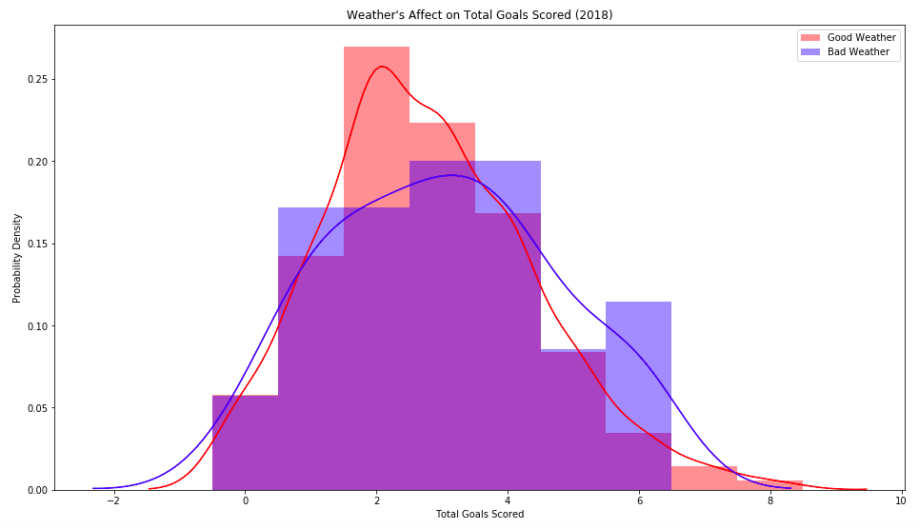
Two sample paired T-test: α=0.05
Null Hypothesis | μ_{good} = μ_{bad}
Alt. Hypothesis | μ_{good} < μ_{bad}
t-statistic | -0.746
p-value | 0.230
P-value > α (0.05) | We fail to reject the null hypothesis
 | Good Weather Goal Count | Bad Weather Goal Count
mean | 2.800 | 3.029
std | 1.588 | 1.740

Slide 6
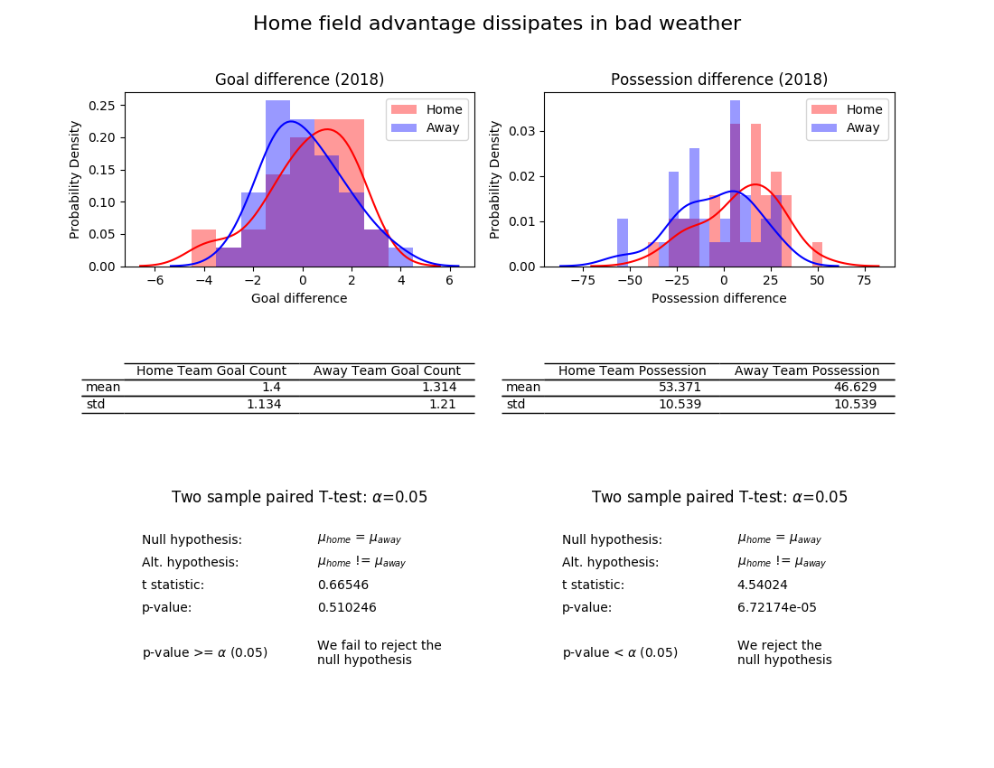
Notes:
In bad weather, at home, teams score 0.1 more goal per match than when away against the same opposition.
But at home in bad weather their possession is 6 percentage points greater than when away

Slide 7
Conclusion
There is a significant home-field advantage for the whole season
No weather metric correlates with total goals scored i.e., the pros know how to play in bad weather
Bad weather makes home-field advantage no longer statistically significant
Notes:
Or else the defense is bad

Slide 8


